Slide 1
Class/Object Relationships
Abstract Class & Interface
CS(217) Object Oriented Programming
Abeeda Akram

Slide 2
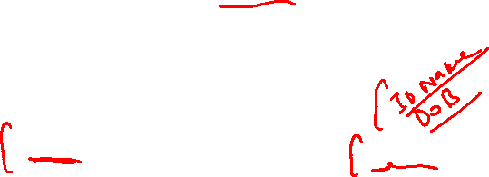
Inheritance (is-a) Concrete classes
Can instantiate or create objects (dynamic and static)
Can also make pointers and references.
Implement all functions defined in a concrete class.
Represent a real time object.
Basic Account
Person
printInfo();
printData();
Saving
Current
Doctor
Patient

Slide 3
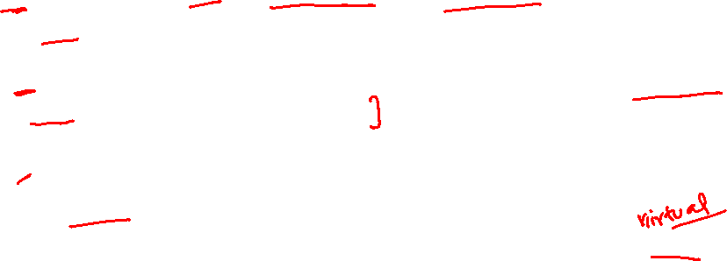
Inheritance (is-a) Concrete classes
void main(){
  Person * p = new Person(1234, “Ali”, “Jamal”, 3, 9, 1989);
  p->printData(); // Print person’s data
  Person * p1 = new Doctor(1234, “Salman”, “Raza”, 3, 9, 1989, “cardiologist”…);
  p1->printData(); // Print Doctors’s data
  Person * p2 = new Patient(1234, “Kamran”, “Shahid”, 3, 9, “Blood Pressure” ..);
  p2->printData(); // Print Patient’s data
}
Person
printData();
Doctor
Patient

Slide 4
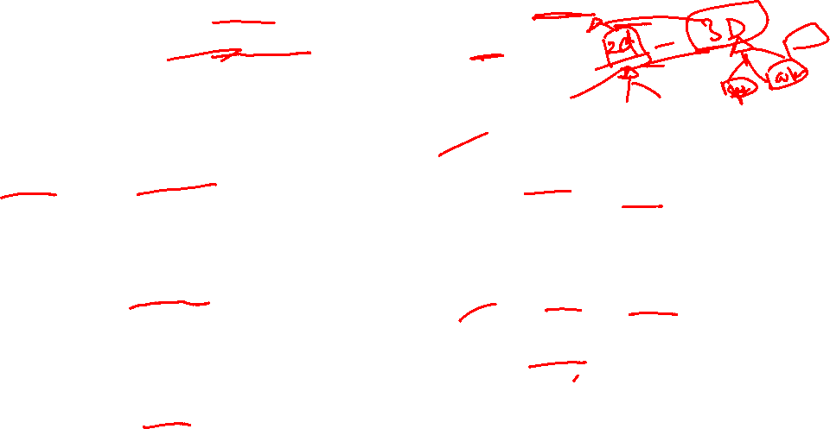
Inheritance (is-a) Abstract classes
Shape
draw();
Abstract class is a concept not a real object, represents a set.
class Shape{
  Point p;
public:
  Shape(int x=0, int y=0) :p(x,y){}
  virtual void draw(){// What to draw?}
};
class Vehicle{
public:
  virtual void drive(){// What to drive?}
};
class Animal{
public:
  virtual void speak(){// What to speak?}
};
Circle
Rectangle
Triangle
Vehicle
drive();
Ship
Car
Plane
Animal
speak();
Snake
Lion
Dog

Slide 5
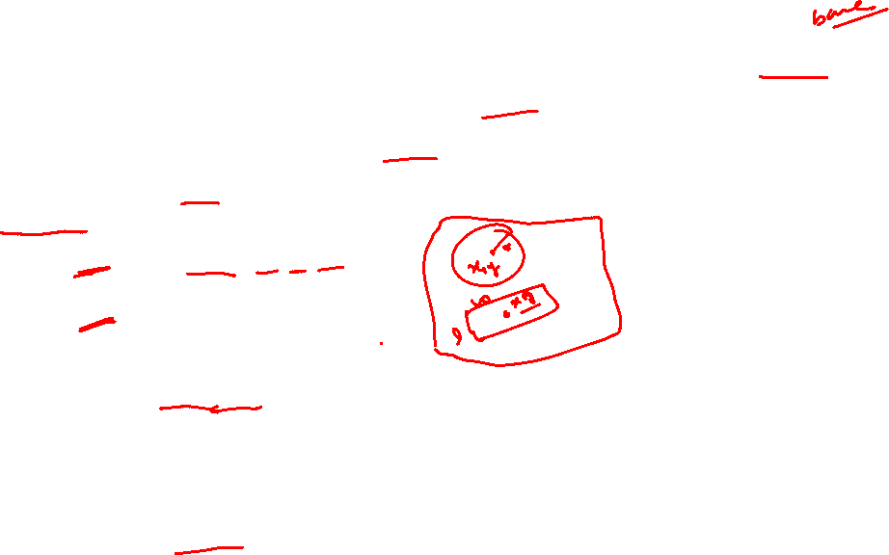
Inheritance (is-a) Abstract classes
Shape
draw();
System allows us to make objects of all base classes.
It is useless to make objects of abstract class.
void main(){
  Shape * s = new Shape(3, 2);
  s->draw(); // What to draw ?
  Shape * s2 = new Circle(3, 2, 5.5);
  s2->draw(); // Draw a circle
  Shape * s3 = new Rectangle(3, 2, 5.5, 6);
  s3->draw(); // Draw a Rectangle
  Animal * a = new Animal;
  a->speak(); // What to Speak ?
  Animal * a2 = new Lion;
  a2->speak(); // Lion Roars
  Vehicle * v = new Vehicle;
  v->drive(); // What to drive ?
}
Circle
Rectangle
Triangle
Vehicle
drive();
Ship
Car
Plane
Animal
speak();
Snake
Lion
Dog

Slide 6
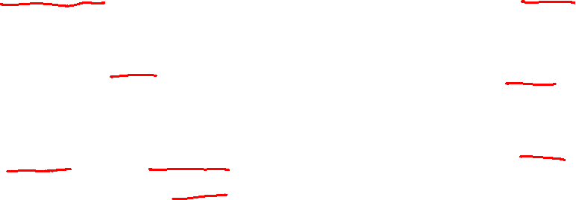
Inheritance (is-a) Abstract classes
Sole purpose of abstract class is to be a base class
  Place common attributes and functions in abstract base class.
Implementation is Incomplete for some functions
  Derived classes should fill in "missing pieces“ according to their type.
Cannot create objects (dynamic or static) of abstract class
  Compiler will show error message, if create object of abstract class.
  However, can create pointers and references of abstract classes.
    Abstract class pointers are still useful for polymorphism.
    We can still make pointer arrays of abstract base classes to store different type of derived objects.
Shape
Vehicle
Animal

Slide 7
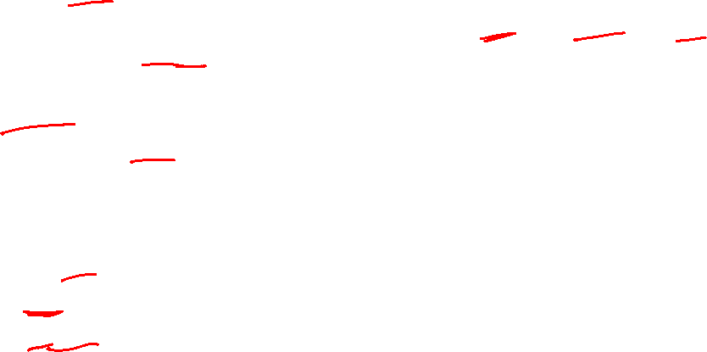
Inheritance (is-a) Abstract classes
Shape
draw();
How to make a class abstract?
  Add one or more "pure" virtual functions in the class.
    Declare function with initializer of 0
    virtual void draw() = 0;
    Pure virtual functions, have no implementation, just add prototype in base class.
    Must be overridden in derived classes according to their type.
    If a derive class do not override a pure virtual function, it also becomes an abstract class.
  Normal virtual functions have implementations, overriding is optional
  Abstract classes can still have data and concrete functions
    Just required to have one or more pure virtual functions
  Must add virtual destructor in abstract class.
  Abstract classes can have constructors
Circle
Rectangle
Triangle

Slide 8

Inheritance (is-a) Abstract classes
Shape
draw();
Make abstract classes by adding pure virtual functions
Must be overridden by derived classes.
class Shape{
  Point p;
public:
  Shape(int x=0, int y=0) :p(x,y){}
  virtual void draw() = 0; // Pure virtual function
};
class Vehicle{
public:
  virtual void drive() = 0; // Pure virtual function
};
class Animal{
public:
  virtual void speak() = 0; // Pure virtual function
};
Circle
Rectangle
Triangle
Vehicle
drive();
Ship
Car
Plane
Animal
speak();
Snake
Lion
Dog

Slide 9
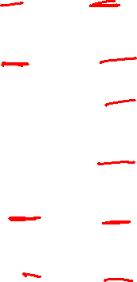
Inheritance (is-a) Abstract classes
Shape
draw();
Now system will not allow us to make objects of Abstract class.
Abstract class pointers are still useful for polymorphism.
void main(){
  Shape * s = new Shape(3, 2);
  // Error: cannot create object of abstract class.
  // Can still point to derived class objects.
  Shape * s2 = new Circle(3, 2, 5.5);
  s2->draw(); // Draw a circle
  Shape * s3 = new Rectangle(3, 2, 5.5, 6);
  s3->draw(); // Draw a Rectangle
  Animal * a = new Animal;
  // Error: cannot create object of abstract class.
  Animal * a2 = new Lion;
  a2->speak(); // Lion Roars
  Vehicle * v = new Vehicle;
  // Error: cannot create object of abstract class.
}
Circle
Rectangle
Triangle
Vehicle
drive();
Ship
Car
Plane
Animal
speak();
Snake
Lion
Dog

Slide 10
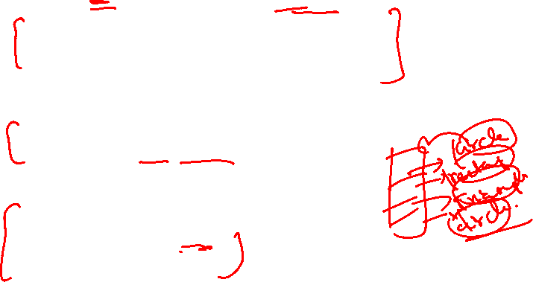
Inheritance (is-a) Abstract classes
We can still make pointer arrays of abstract base classes to store different type of derived objects.
void main(){
  Shape ** shapes = new Shape*[10];
  shapes[0] = new Circle(2,9,5);
  shapes[1] = new Rectangle(3,8,9,7);
  shapes[2] = new Triangle(3,2,6,5);
  ….
//Draw different shapes according to type
  for(int i=0; i<10 ;i++)
  shapes [i]->draw();
//Deallocate list
  for(int i=0; i<10 ;i++)
  delete shapes[i];
  delete [] shapes;
}
Shape
draw();
Circle
Rectangle
Triangle

Slide 11
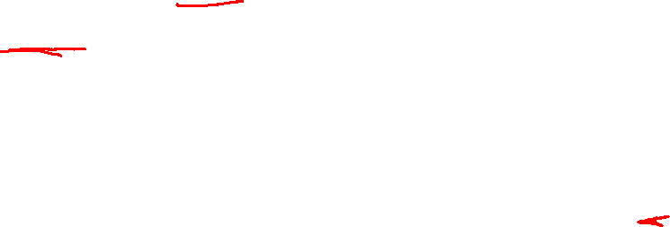
Inheritance (is-a) Interface
A special type of class, which has no data members.
All functions are pure virtual.
Derived class must implement all pure virtual functions.
  If it skip implementation of any function, then it will become an abstract class.
Must add virtual destructor in interface class.
Name of Interface classes usually begin with letter “I”.
  Just to differentiate it from other classes.

Slide 12
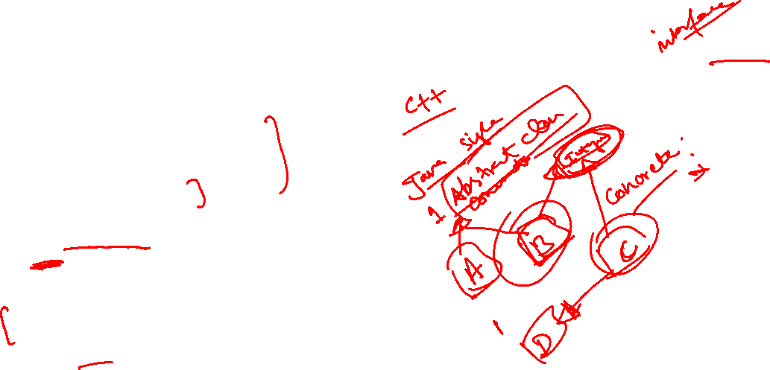
Inheritance (is-a) Interface
IExample
class IExample{
public:
// Pure virtual functions
  virtual void Function1() = 0;
  virtual void Function2() = 0;
  virtual void Function3() = 0;
  virtual ~IExample();
};
class A: public IExample{
  int a;
public:
  A(int a=0){ this->a=a;}
  virtual void print(){ cout<<a;}
  virtual ~A(){}
  // Must implement all Pure virtual functions.
};
A

